Slide 1

Voice Based Virtual Assistant

Slide 2
Submitted By:
Name | Roll number | PRN
Anupam Sharma | 40 | 2114110041
Raj Harsh Vardhan | 51 | 2114110052
Sriyansh Shivam | 62 | 2114110063
Anurag Singh | 44 | 2114110045

Slide 3
Introduction
Voice-based AI assistants are a rapidly evolving technology that leverages artificial intelligence and natural language processing to provide users with a seamless and interactive way to interact with computers, devices, and services through spoken language. These assistants, also known as virtual voice assistants or voice-activated virtual assistants, have become increasingly popular in recent years due to their convenience and versatility

Slide 4
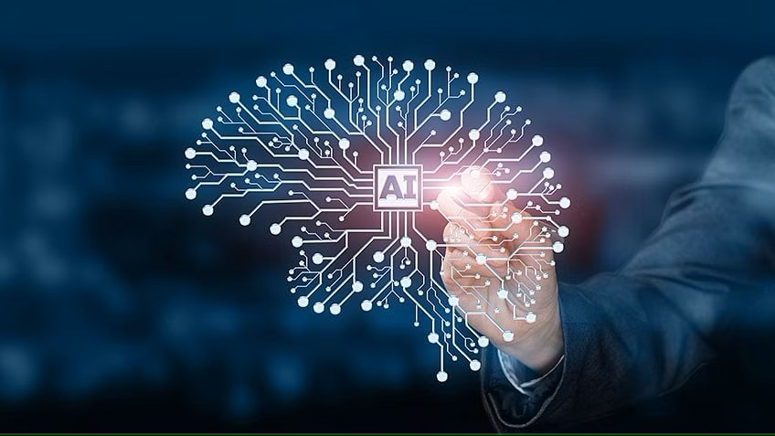

Key Features:
Natural Language Understanding: Voice-based AI assistants can understand and interpret human speech, allowing users to interact with them in a conversational and intuitive manner. This is made possible by advanced natural language processing algorithms.
Voice Recognition: They have sophisticated voice recognition technology that can accurately identify and distinguish individual voices, enabling personalized interactions.

Slide 5
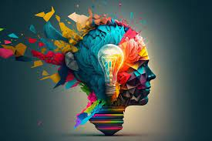
Task Automation: Voice assistants can perform a wide range of tasks, such as setting alarms, sending messages, making phone calls, controlling smart home devices, and providing information, all through voice commands
Integration with Other Services: They are often integrated with various online services and applications, allowing users to access information, play music, order products, and perform many other tasks simply by speaking.

Slide 6
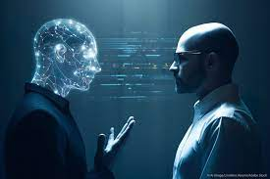
Motivation:
The motivation for exploring and developing voice-based AI assistants stems from several key factors that make this technology compelling and impactful. These motivations include:
Convenience and Accessibility: Voice-based AI assistants make technology more accessible to a broader range of individuals, including those who may have limited experience with traditional computing interfaces or those with disabilities. By enabling interactions through spoken language, they provide a more intuitive and inclusive way for people to access information and perform tasks.

Slide 7
Natural Interaction: Interacting with voice-based AI assistants feels more natural and human-like, as it leverages our inherent ability to speak and understand spoken language. This makes technology more approachable, reducing the learning curve for using devices and services.
Integration with Smart Devices: The increasing prevalence of smart home devices and the Internet of Things (IoT) has motivated the development of voice assistants that can control these devices. Users can seamlessly manage their home environments, from adjusting the thermostat to locking doors, through voice commands.
Personalization: Voice assistants can learn from user interactions, adapting to individual preferences and providing personalized recommendations. This motivates users to continue using them, as the experience becomes more tailored and useful over time.

Slide 8

Efficiency and Time-Saving: Voice assistants can streamline various tasks, such as setting reminders, sending messages, or searching for information, allowing users to save time and be more efficient in their daily activities. This efficiency motivates users to adopt and rely on these technologies.

Slide 9
Popular Voice Based Assistant:
Siri (Apple): Siri is Apple's virtual assistant, available on iOS devices, Macs, and HomePod. It can help with tasks, answer questions, and control smart home devices.
Google Assistant: Google's AI assistant is available on Android devices and through various Google services. It can provide information, perform tasks, and control compatible smart devices.
Amazon Alexa: Alexa is the voice assistant for Amazon's Echo devices. It can control smart home devices, answer questions, and even play music or set up routines.
Microsoft Cortana: Initially developed for Windows, Cortana is a voice assistant that can help with tasks, answer questions, and manage your calendar.

Slide 10
Bixby (Samsung): Bixby is Samsung's voice assistant, integrated into their smartphones and other devices. It can perform various tasks and control Samsung appliances.
Assistant by OpenAI (GPT-3 based): OpenAI has developed AI models that can be used to create custom voice assistants. These models, like GPT-3, can understand and generate human-like text and speech.

Slide 11
Literature Survey:
Natural Language Processing (NLP) and Speech Recognition:
Human-Computer Interaction:
Many studies explore the underlying NLP and speech recognition technologies that enable voice-based virtual assistants to understand and respond to human language.
Research focuses on improving accuracy, speed, and robustness of voice recognition, making interactions more seamless.
This area examines how users interact with voice assistants and how to improve the user experience. It includes topics like interface design, user satisfaction, and usability testing.
Researchers aim to make interactions more intuitive and user-friendly.

Slide 12
Personalization and Context Awareness:
Machine Learning and Deep Learning:
Researchers investigate methods for voice assistants to adapt to individual user preferences and provide context-aware responses. Personalization enhances the user experience and engagement.
Voice recognition and natural language understanding heavily rely on machine learning and deep learning algorithms. Research in this field focuses on optimizing these models for speech recognition and NLP tasks.

Slide 13
Open-Source Development and DIY Voice Assistants:
Market trends
With the rise of open-source platforms, there is a growing interest in creating DIY voice assistants. Research in this area examines the possibilities and challenges of building custom voice assistants
The adoption of voice-based virtual assistants in commercial settings is an area of interest. Studies analyze market trends, business strategies, and the economic impact of these technologies.

Slide 14
Implementation:
Listening for Commands:
Inside play_jarvis(), we start by listening for your voice commands.
Processing Commands:
We check the recognized command and take actions accordingly. For example:
If you say "play," it will play a song on YouTube.
If you say "time," it will tell you the current time.
If you say "date," it will provide the current date.
If you ask "how are you," it responds politely.
If you ask "who is," it searches Wikipedia for information about a person.
Responding to Commands:
The virtual assistant responds to your command with either a message or relevant information.
Infinite Loop:
The code is set up in a while loop, so you can keep interacting with the virtual assistant. Just remove the comments from # while True: to make it active.
Importing Necessary Libraries:
We start by importing the required libraries:
speech_recognition as aa for speech recognition.
pyttsx3 for text-to-speech functionality.
pywhatkit for searching and playing music on YouTube.
datetime for getting the current date and time.
wikipedia for fetching information from Wikipedia.
Initializing Speech Recognition and Text-to-Speech:
We initialize the speech recognizer and text-to-speech engine.
Defining Functions:
talk(text) is a function to make our virtual assistant speak.
input_instruction() listens to your voice and converts it into text.
play_jarvis() is the main function that processes your commands.

Slide 15
Application:
Smart Homes: Voice assistants are often used to control smart home devices, adjusting lighting, thermostats, and more with simple voice commands.
Customer Service: Many companies use AI assistants for customer service, automating responses and providing quick solutions to user inquiries.
Accessibility: Voice-based AI assistants have made technology more accessible to people with disabilities, allowing them to control devices and access information using their voices.

Slide 16
Personal Productivity: Users can rely on voice assistants to set reminders, manage calendars, send emails, and perform other productivity tasks.
Entertainment: These assistants can provide recommendations for movies, music, and other forms of entertainment.

Slide 17
Inferences:
Natural Language Processing: The foundation of voice-based virtual assistants lies in natural language processing and speech recognition technologies. These assistants are continually improving in their ability to understand and respond to human speech.
User-Centric Approach: User experience is a primary focus in the development of voice assistants. Researchers and developers are striving to make interactions more intuitive, user-friendly, and personalized to enhance user satisfaction.
Multifunctionality: Voice assistants are versatile, capable of performing a wide range of tasks, from answering questions to controlling smart home devices and providing entertainment. This multifunctionality adds significant value to users' lives.

Slide 18
Applications Across Industries: Voice-based virtual assistants have found applications in various sectors, including healthcare, education, customer service, and smart homes. They are transforming the way people access information and interact with devices.
Privacy and Security Challenges: As voice assistants process and store voice data, privacy and security concerns are paramount. Researchers are actively working on safeguarding user data and ensuring secure voice recognition.

Slide 19
CONCLUSION:
The development and implementation of a voice-based virtual assistant project has been a significant journey, aimed at enhancing user experiences and simplifying everyday tasks through natural language interaction.
In conclusion, the voice-based virtual assistant project represents a significant step towards creating an intelligent and user-centric digital assistant. Its potential applications are vast, ranging from simplifying daily tasks to supporting individuals with accessibility needs. The project's success has been possible through the dedication of our team, and we are committed to refining and expanding its capabilities to better serve our users in the future.

